Slide 1

Robot Framework & Appium For Mobile App
08/2016

Slide 2
Agenda:
1. What is Appium
2. Demo
3. Setup Appium on Mac OS X for iOS
4. How To Locating Element For iOS
5. Setup Appium on Mac OS X for Android
6. How To Locating Element For Android
7. Setup Appium on Window
8. Setup Appium on Window for Android
9. RF & Appium for iOS on MAC
10. RF & Appium for Android
11. Compare usage of Robotframework/appium on different platforms (Android Vs IOS)

Slide 3
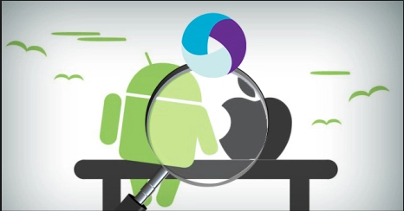
1. What is Appium?
Appium is an open source test automation framework for use with native, hybrid and mobile web apps. It drives iOS and Android apps using the WebDriver protocol.
Homepage : http://appium.io/

Slide 4
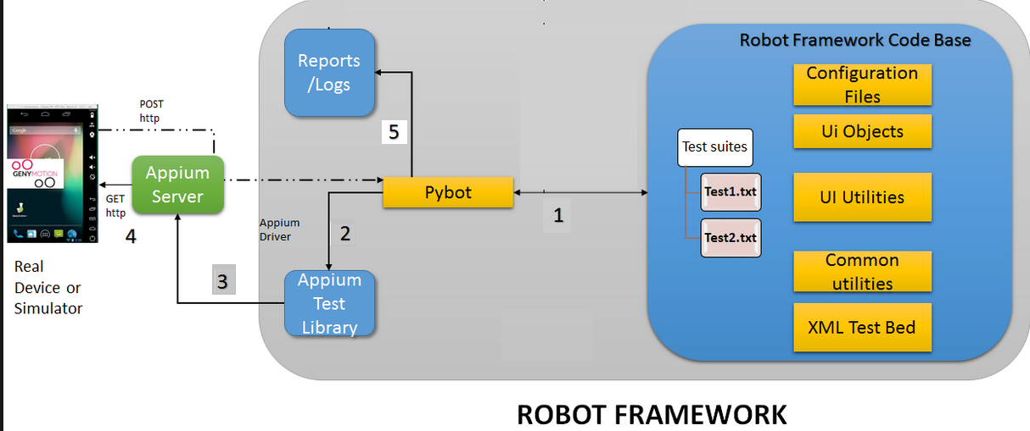
1. What is Appium?

Slide 5
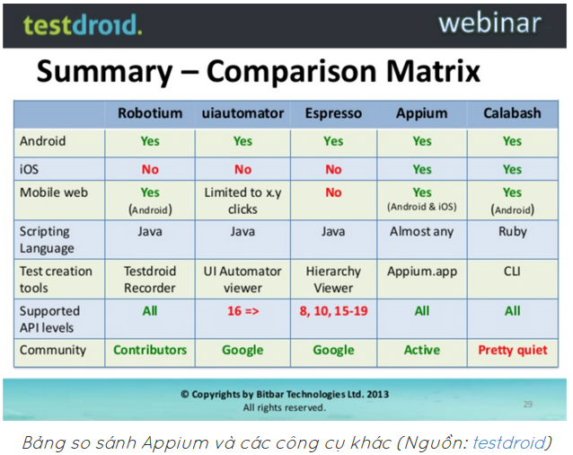

Slide 6
2. Demo

Slide 7
Agenda:
1. What is Appium
2. Demo
3. Setup Appium on Mac OS X for iOS
4. How To Locating Element For iOS
5. Setup Appium on Mac OS X for Android
6. How To Locating Element For Android
7. Setup Appium on Window
8. Setup Appium on Window for Android
9. RF & Appium for iOS on MAC
10. RF & Appium for Android
11. Compare usage of Robotframework/appium on different platforms (Android Vs IOS)

Slide 8
3. Setup Appium on Mac OS X for iOS
Appium on OS X supports iOS and Android testing.
2. Setup : https://horaceheaven.com/automated-functional-testing-native-ios-apps-using-robotframework-and-appium/
3. Reference : http://appium.io/slate/en/master/?ruby#running-appium-on-mac-os-x

Slide 9
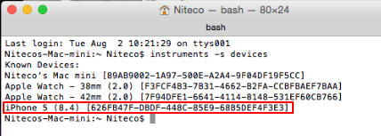
3. Setup Appium on Mac OS X for iOS
4. On your device , open : Setting > Developer > turn on : Enable UI Automation.
5. Check connected device : open terminal and type : instruments -s devices

Slide 10
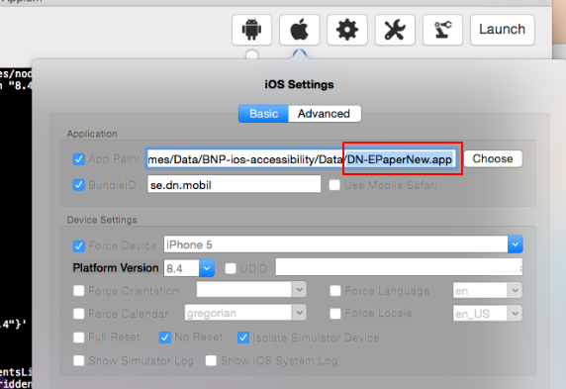
3. Setup Appium on Mac OS X for iOS
6. On MAC , start Appium and setting up for Simulator
In simulator you have to use “.app” file.
To create app file, refer : (https://www.youtube.com/watch?v=d1u58t-ko6s)

Slide 11

3. Setup Appium on Mac OS X for iOS
7. On MAC , start Appium and setting up for Real device
Repeat step 4-5

Slide 12
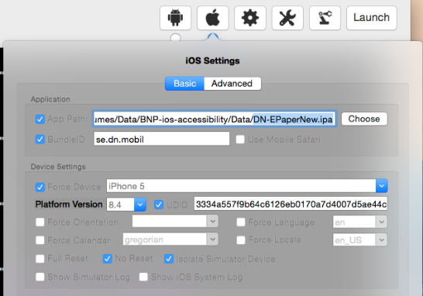
3. Setup Appium on Mac OS X for iOS
7. On MAC , start Appium and setting up for Real device
b. In real device you have to use “ipa” file

Slide 13
Agenda:
1. What is Appium
2. Demo
3. Setup Appium on Mac OS X for iOS
4. How To Locating Element For iOS
5. Setup Appium on Mac OS X for Android
6. How To Locating Element For Android
7. Setup Appium on Window
8. Setup Appium on Window for Android
9. RF & Appium for iOS on MAC
10. RF & Appium for Android
11. Compare usage of Robotframework/appium on different platforms (Android Vs IOS)

Slide 14
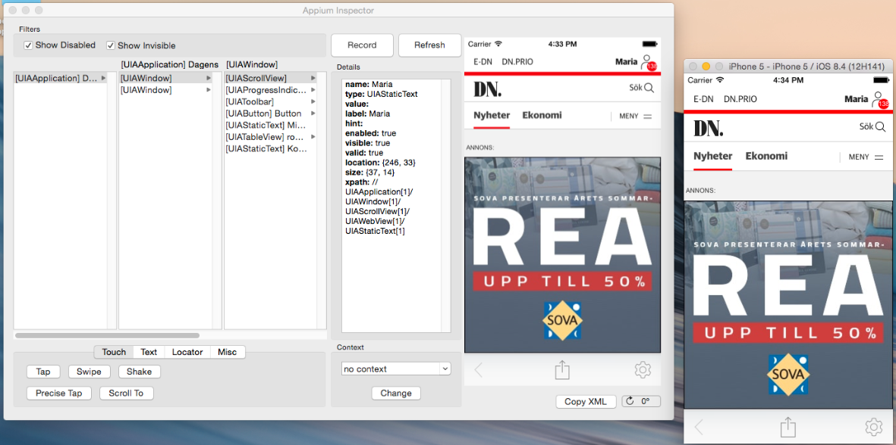
4. How To Locating Element For iOS
Click Launch button, wait some seconds to completed startup appium then click magnifying glass icon.

Slide 15
Agenda:
1. What is Appium
2. Demo
3. Setup Appium on Mac OS X for iOS
4. How To Locating Element For iOS
5. Setup Appium on Mac OS X for Android
6. How To Locating Element For Android
7. Setup Appium on Window
8. Setup Appium on Window for Android
9. RF & Appium for iOS on MAC
10. RF & Appium for Android
11. Compare usage of Robotframework/appium on different platforms (Android Vs IOS)

Slide 16
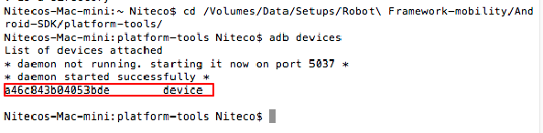
5. Setup Appium on Mac OS X for Android
Setup : download and setup “Android – sdk “ on MAC ( refer : android-sdk_r24.0.2-macosx.zip )
Check for connected devices :
On your device , open : Setting > General > developer report > checked on : USB Debugging

Slide 17
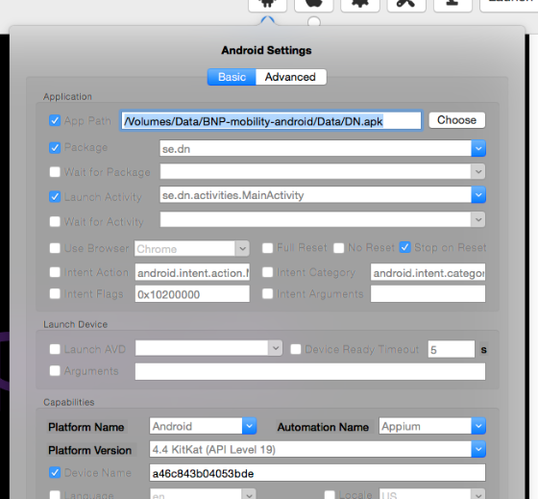
5. Setup Appium on Mac OS X for Android
4. On MAC , start Appium and setting up for Real Android device
a. Setup Appium :

Slide 18
Agenda:
1. What is Appium
2. Demo
3. Setup Appium on Mac OS X for iOS
4. How To Locating Element For iOS
5. Setup Appium on Mac OS X for Android
6. How To Locating Element For Android
7. Setup Appium on Window
8. Setup Appium on Window for Android
9. RF & Appium for iOS on MAC
10. RF & Appium for Android
11. Compare usage of Robotframework/appium on different platforms (Android Vs IOS)

Slide 19
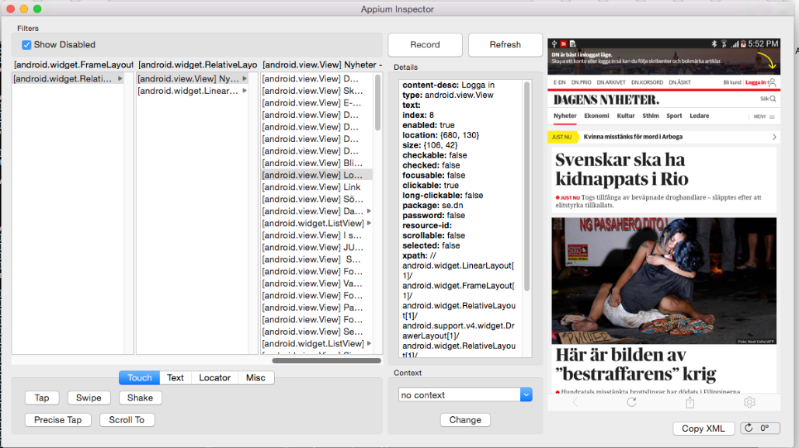
6. How To Locating Element For Android
1. Way 1 Appium inspector : Click Launch button, wait some seconds to completed startup appium then click magnifying glass icon.

Slide 20
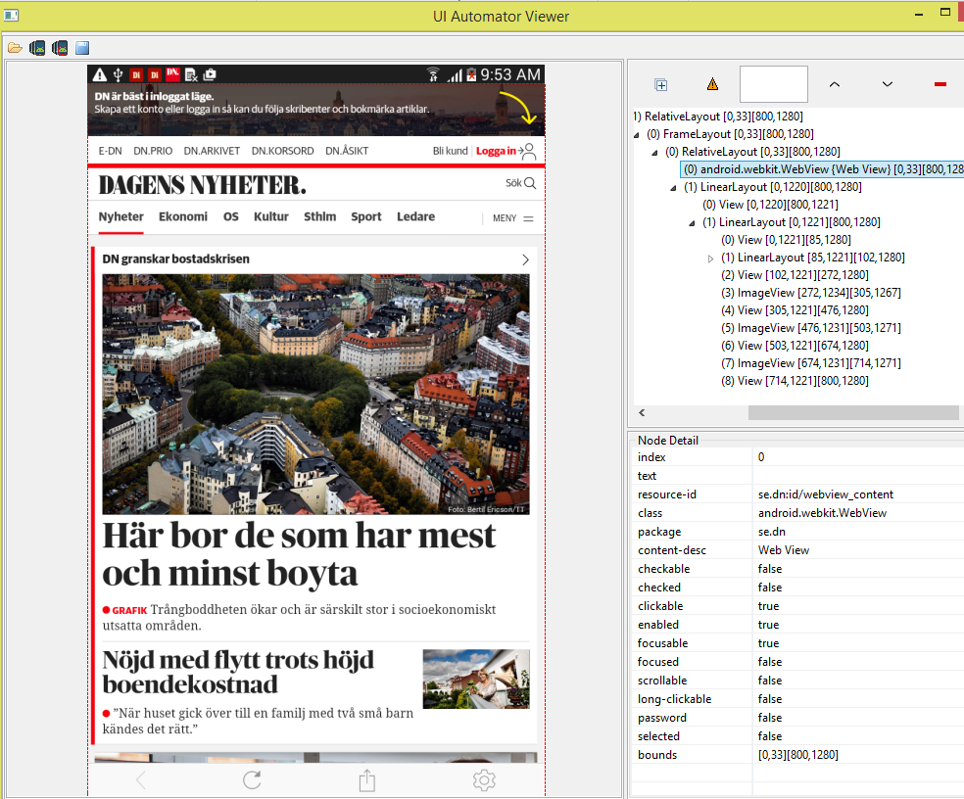
6. How To Locating Element For Android
2. Way 2 : open uiautomatorviewer.bat (C:\Users\user.name\AppData\Local\Android\sdk\tools)

Slide 21
Agenda:
1. What is Appium
2. Demo
3. Setup Appium on Mac OS X for iOS
4. How To Locating Element For iOS
5. Setup Appium on Mac OS X for Android
6. How To Locating Element For Android
7. Setup Appium on Window
8. Setup Appium on Window for Android
9. RF & Appium for iOS on MAC
10. RF & Appium for Android
11. Compare usage of Robotframework/appium on different platforms (Android Vs IOS)

Slide 22
7. Running Appium on Window
Limitations :You will not be able to test iOS apps on a locally hosted server, because Appium relies on OS X-only libraries to support iOS testing. You can however use the Remote Server option to connect to an Appium server running on a Mac.
2. Reference : http://appium.io/slate/en/master/?ruby#running-appium-on-windows

Slide 23
8. Setup Appium on Window for Android
Setup appium : http://www.8bitavenue.com/2012/12/robotframework-android-automation/
Start appium same as on MAC for android app.

Slide 24
Agenda:
1. What is Appium
2. Demo
3. Setup Appium on Mac OS X for iOS
4. How To Locating Element For iOS
5. Setup Appium on Mac OS X for Android
6. How To Locating Element For Android
7. Setup Appium on Window
8. Setup Appium on Window for Android
9. RF & Appium for iOS on MAC
10. RF & Appium for Android
11. Compare usage of Robotframework/appium on different platforms (Android Vs IOS)

Slide 25
9. RF & Appium for iOS on MAC
Setup AppiumLibrary for robot framework : https://github.com/jollychang/robotframework-appiumlibrary
2. From RF setup command :
Open Application http://localhost:4723/wd/hub
platformName=iOS
platformVersion=8.4
deviceName=iPhone 5
bundleld=se.dn.mobil
app=../DN-EpaperNew.app ( OR ../DN-EpaperNew.ipa)
For real device, need to add :
udid=54f6a1e138163a625ba44c8c00c7f2b4aa3fbc36 (get by check : instruments -s devices)

Slide 26
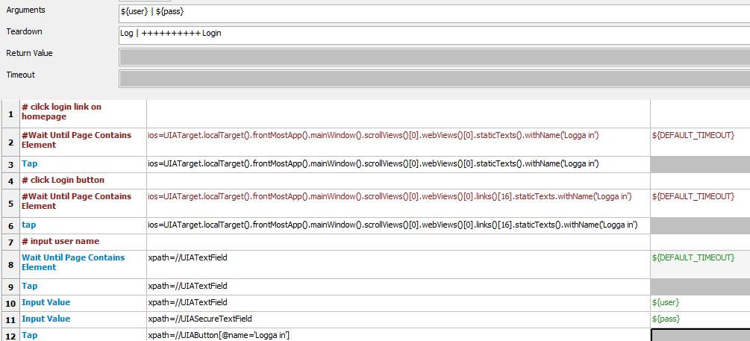
9. RF & Appium for iOS on MAC
3. Code example :

Slide 27
Agenda:
1. What is Appium
2. Demo
3. Setup Appium on Mac OS X for iOS
4. How To Locating Element For iOS
5. Setup Appium on Mac OS X for Android
6. How To Locating Element For Android
7. Setup Appium on Window
8. Setup Appium on Window for Android
9. RF & Appium for iOS on MAC
10. RF & Appium for Android
11. Compare usage of Robotframework/appium on different platforms (Android Vs IOS)

Slide 28
10. RF & Appium for Android
Setup AppiumLibrary for robot framework : https://github.com/jollychang/robotframework-appiumlibrary
2. From RF setup command :
Open Application http://localhost:4723/wd/hub platformName=Android
platformVersion=4.4.2
deviceName=a46c843b04053bde
appPackage=se.dn
appActivity=se.dn.activities.MainActivity

Slide 29
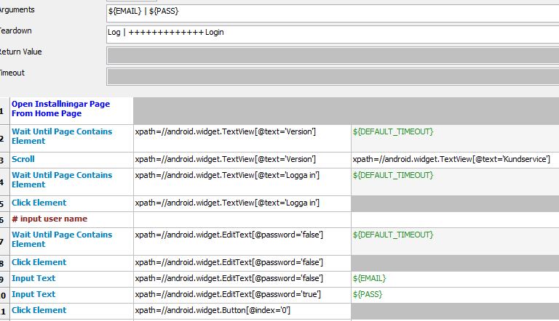
10. RF & Appium for Android
3. Code example :

Slide 30
Agenda:
1. What is Appium
2. Demo
3. Setup Appium on Mac OS X for iOS
4. How To Locating Element For iOS
5. Setup Appium on Mac OS X for Android
6. How To Locating Element For Android
7. Setup Appium on Window
8. Setup Appium on Window for Android
9. RF & Appium for iOS on MAC
10. RF & Appium for Android
11. Compare usage of Robotframework/appium on different platforms (Android Vs IOS)

Slide 31
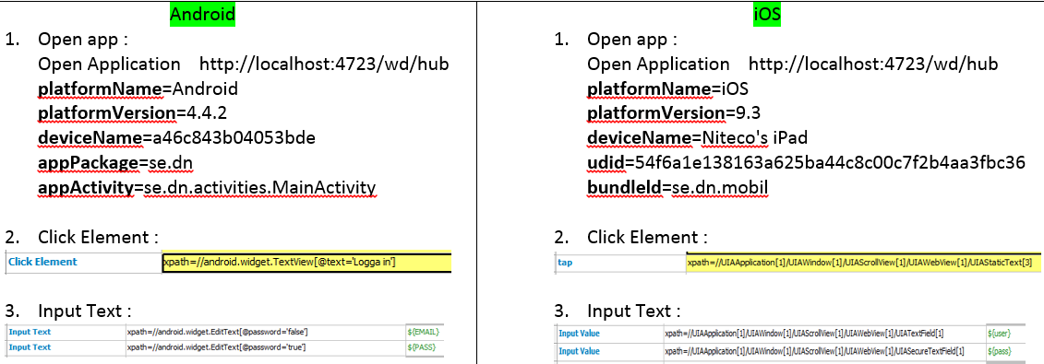
11. Compare usage of Robotframework/appium on different platforms (Android Vs IOS)

Slide 32
Q&A

